Slide 1


Department of Computer Science
University Institute of Engineering
DEPARTMENT OF COMPUTER SCIENCE & ENGINEERING
Bachelor of Engineering
Subject Name: System Programming
Subject Code: CST-315
Compilers
DISCOVER . LEARN . EMPOWER

Slide 2
Chapter-2.1 Compilers
Department of computer Science
syntax analysis
Intermediate Code Generation

Slide 3
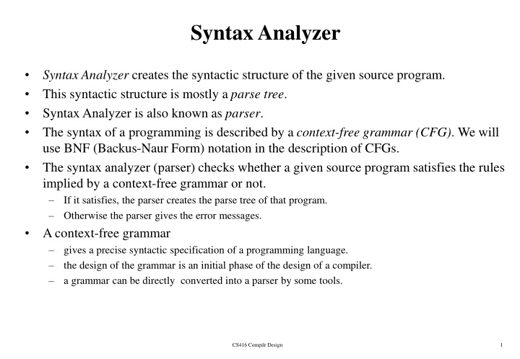

Slide 4
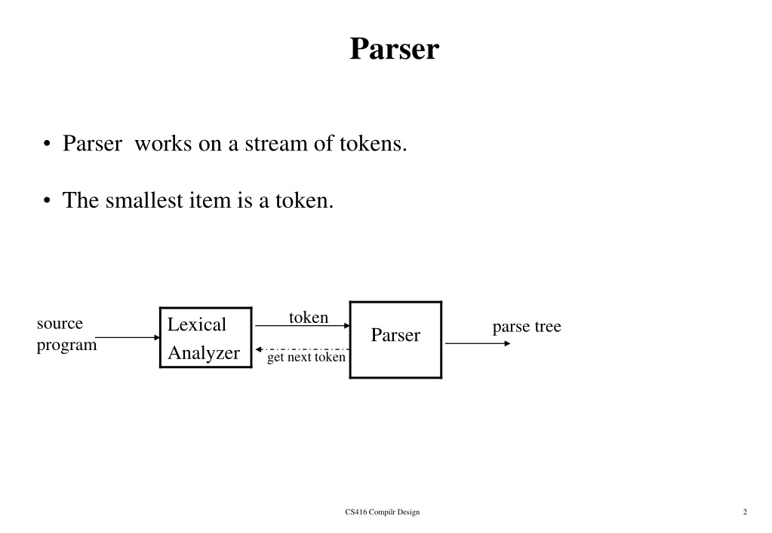

Slide 5
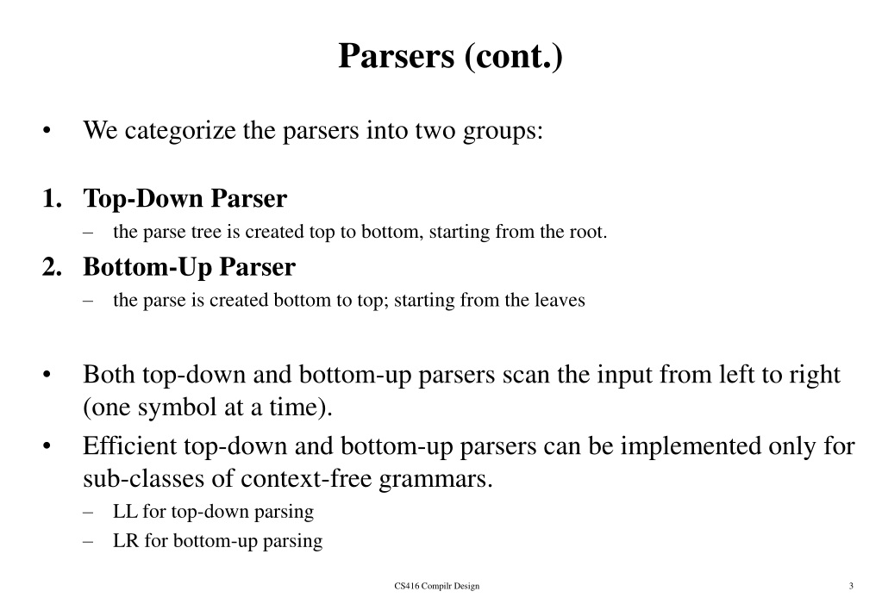

Slide 6
Context Free Grammer
Definition − A context-free grammar (CFG) consisting of a finite set of grammar rules is a quadruple (N, T, P, S) where
N is a set of non-terminal symbols.
T is a set of terminals where N ∩ T = NULL.
P is a set of rules, P: N → (N ∪ T)*, i.e., the left-hand side of the production rule P does have any right context or left context.
S is the start symbol.
Example
The grammar ({A}, {a, b, c}, P, A), P : A → aA, A → abc.
The grammar ({S, a, b}, {a, b}, P, S), P: S → aSa, S → bSb, S → ε
The grammar ({S, F}, {0, 1}, P, S), P: S → 00S | 11F, F → 00F | ε

Slide 7
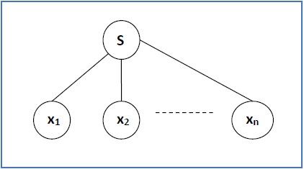
Generation of Derivation Tree
A derivation tree or parse tree is an ordered rooted tree that graphically represents the semantic information like a string derived from a context-free grammar.
Representation Technique
Root vertex − Must be labeled by the start symbol.
Vertex − Labeled by a non-terminal symbol.
Leaves − Labeled by a terminal symbol or ε.
If S → x₁x₂ …… x_{n} is a production rule in a CFG, then the parse tree / derivation tree will be as follows −

Slide 8
Derivation Tree Approaches
There are two different approaches to draw a derivation tree −
Top-down Approach −
Starts with the starting symbol S
Goes down to tree leaves using productions
Bottom-up Approach −
Starts from tree leaves
Proceeds upward to the root which is the starting symbol S

Slide 9
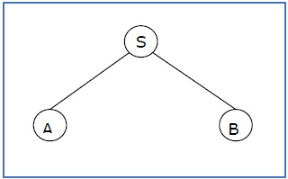
Sentential Form and Partial Derivation Tree
A partial derivation tree is a sub-tree of a derivation tree/parse tree such that either all of its children are in the sub-tree or none of them are in the sub-tree.
Example
If in any CFG the productions are −
S → AB, A → aaA | ε, B → Bb| ε
the partial derivation tree can be the following −
If a partial derivation tree contains the
root S, it is called a sentential form. The
above sub-tree is also in sentential form.

Slide 10
Left and Right Derivation Tree
Leftmost and Rightmost Derivation of a String
Leftmost derivation − A leftmost derivation is obtained by applying production to the leftmost variable in each step.
Rightmost derivation − A rightmost derivation is obtained by applying production to the rightmost variable in each step.
Example
Let any set of production rules in a CFG be
X → X+X | X*X |X| a
The leftmost derivation for the string "a+a*a" may be −
X → X+X → a+X → a + X*X → a+a*X → a+a*a
The rightmost derivation for the above string "a+a*a" may be −
X → X*X → X*a → X+X*a → X+a*a → a+a*a

Slide 11
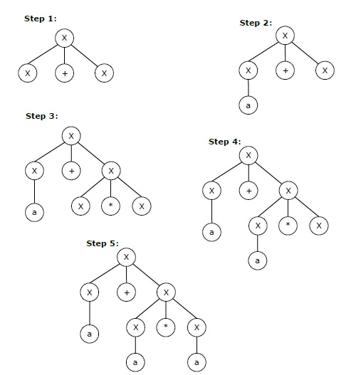
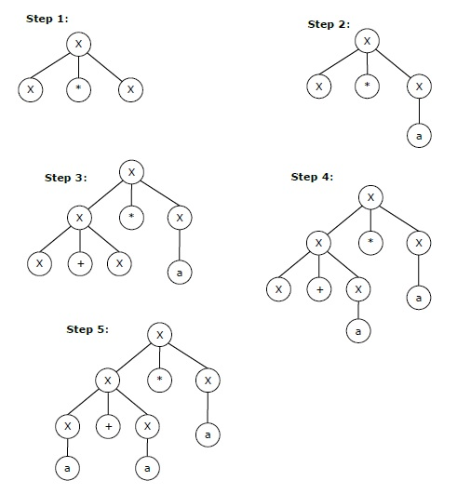
Left Most Derivation X → X+X → a+X → a + X*X → a+a*X → a+a*a Right Most Derivation X → X*X → X*a → X+X*a → X+a*a → a+a*a

Slide 12
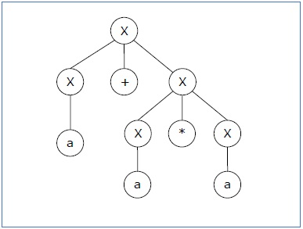
Ambiguous Grammar
If a context free grammar G has more than one derivation tree for some string w ∈ L(G), it is called an ambiguous grammar. There exist multiple right-most or left-most derivations for some string generated from that grammar.
Check whether the grammar G with production rules −
X → X+X | X*X |X| a is ambiguous or not.
Derivation 1 −
X → X+X → a +X → a+ X*X → a+a*X → a+a*a
Parse Tree->

Slide 13
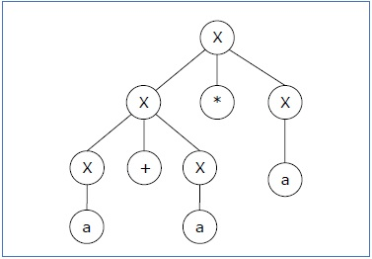
Derivation 2 − X → X*X → X+X*X → a+ X*X → a+a*X → a+a*a
Since there are two parse trees for a single string "a+a*a", the grammar G is ambiguous.

Slide 14
Closure Properties of CFG
Context-free languages are closed under −
Union
Concatenation
Kleene Star operation
Union
Let L₁ and L₂ be two context free languages. Then L₁ ∪ L₂ is also context free.
Concatenation
If L₁ and L₂ are context free languages, then L₁L₂ is also context free.
Kleene Star
If L is a context free language, then L* is also context free.

Slide 15
Syntax Analysis
Lexical Analysis (Scanner) Syntax Analysis (Parser) characters tokens abstract syntax tree.
Lexical and Syntax Analysis Languages are designed for both phases
For characters, we have the language of regular expressions to recognize tokens.
For tokens, we have context free grammars to recognize syntactically correct programs.

Slide 16
Intermediate Code Generation
During the translation of a source program into the object code for a target machine, a compiler may generate a middle-level language code, which is known as intermediate code or intermediate text.
The complexity of this code lies between the source language code and the object code.
The intermediate code can be represented in the form of postfix notation, syntax tree, directed acyclic graph (DAG), three-address code, quadruples, and triples.

Slide 17
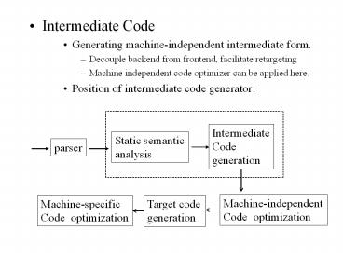

Slide 18
Different Types of Intermediate codes
Intermediate code must be easy to produce and easy to translate to machine code
It is a sort of universal assembly language.
It should not contain any machine-specific parameters (registers, addresses, etc.)
The type of intermediate code deployed is based on the application like Quadruples, triples, indirect triples, abstract syntax trees are the classical forms used for machine-independent optimizations and machine code generation.

Slide 19
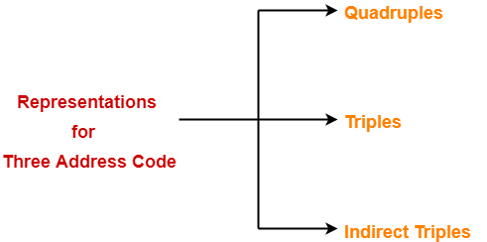
The commonly used representations for implementing Three Address Code are-
The commonly used representations for implementing Three Address Code are-

Slide 20
Three Address Code
Three-address code is a generic form and can be implemented as quadruples, triples, indirect triples, tree or DAG.
For example:
a = b + c * d;
The intermediate code generator will try to divide this expression into sub-expressions and then generate the corresponding code.
r1 = c * d;
r2 = b + r1;
a = r2
LHS is the target and the RHS has at most two sources and one operator
RHS sources can be either variables or constants

Slide 21
a) Quadruples
Each instruction in quadruples presentation is divided into four fields: operator, arg1, arg2, and result. The above example is represented below in quadruples format:
Op | arg1 | arg2 | result
* | c | d | r1
+ | b | r1 | r2
+ | r2 |  | a

Slide 22
b) Triples
The triples have three fields to implement the three address code. The field of triples contains the name of the operator, the first source operand and the second source operand.
In triples, the results of respective sub-expressions are denoted by the position of expression. Triple is equivalent to DAG while representing expressions.
Example: a := -b * c + d
t₁ := -b t₂ := c + d M t₃ := t₁ * t₂ a := t₃
Three address code is as follows:
 | Operator | Source 1 | Source 2
(0) | uminus | b | -
(1) | + | c | d
(2) | * | (0) | (1)
(3) | := | (2) | -

Slide 23
Indirect Triples
Triples face the problem of code immovability while optimization, as the results are positional and changing the order or position of an expression may cause problems.
This representation is an enhancement over triples representation. It uses pointers instead of position to store results. This enables the optimizers to freely re-position the sub-expression to produce an optimized code.

Slide 24
Indirect Triples
Statement
35 | (0)
36 | (1)
37 | (2)
38 | (3)
39 | (4)
40 | (5)

Slide 25
Three Address Code
Example: The three-address code for a+b*c-d/(b*c) is below
t1 = b*c
t2 = a+t1
t3 = b*c
t4 = d/t3
t5 = t2-t4

Slide 26
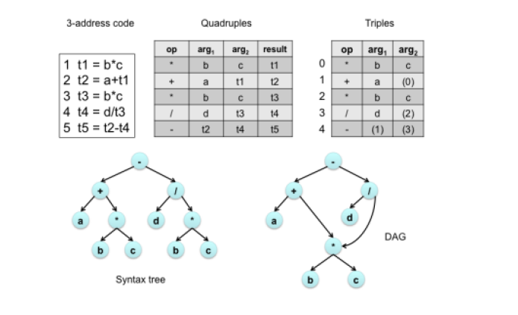
Implementation of three address code

Slide 27
References
Department of computer Science
[PDF] Systems Programming and Operating Systems by Dhamdhere - Free Download PDF (dlscrib.com)
[PDF] Principles of Compiler Design By Alfred V. Aho & J.D.Ullman Free Download – Learnengineering.in

Slide 28

THANK YOU

